Slide 1
The Battle of Neighborhoods
Opening new African Restaurant in London, UK

Slide 2
1. Introduction
1.1. Problem
The population of London has grown considerably over the last decades. London is very diverse. It represents what is called the reflection of the old British Empire. In London, you can get fresh from food supplies from Africa. One begins to wonder the efficiency of the supply mechanism.
The real deal is that as much as there are many fine restaurants in London – Asian, Middle Eastern, Latin and American restaurants, you can struggle to find good place to dine in the finest of West African cuisine that has combination of Nigerian, Ghanaian, Cameroonian, Senegalese and more.
1.2. Background
My client, a successful restaurant chain in Africa is looking to expand operation into Europe through London. They want to create a high-end restaurant that comes with organic mix and healthy. Their target is not only West Africans, but they are pro-organic and healthy eating. To them every meal counts and counts as a royal when you eat.
Since the London demography is so big, my client needs deeper insight from available data in other to decide where to establish the first Europe “palace” restaurant. This company spends a lot on research and provides customers with data insight into the ingredients used at restaurants.

Slide 3
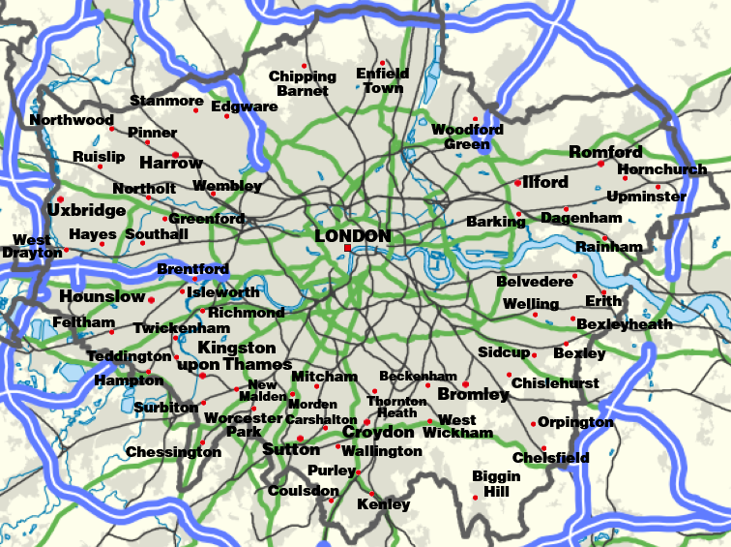
areas of London

Slide 4
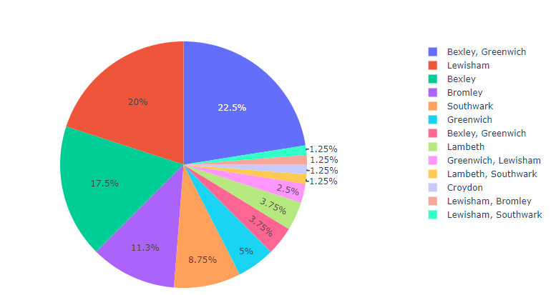
Borough of London

Slide 5
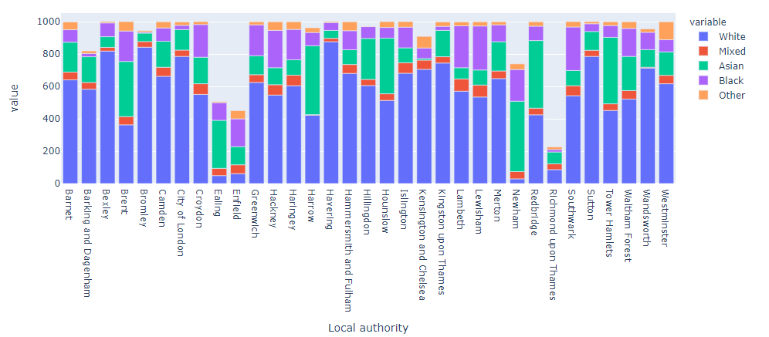
demography of London

Slide 6
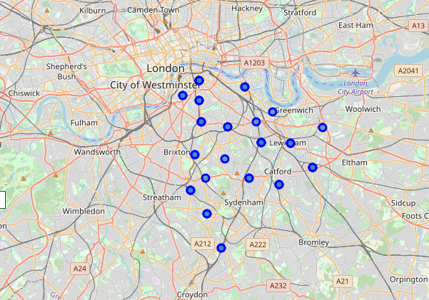
Location information (latitude and longitude) of neighborhoods

Slide 7
4. Results
The following are the highlights of the 5 clusters:
1.Pubs, Cafe, Coffee Shops are popular in the South East London. 2.As for restaurants, the Italian Restaurants are very popular in the South East London area. Especially in Southwark and Lambeth areas. 3.With the Lewisham area being the most condensed area of Africans in the South East Area, it is surprising to see how in the top 10 venues, you can barely see restaurants in the top 5 venues. 5.Although, the Clusters have variations, a very visible presence is the predominance of pubs
5. Discussion & Conclusion
It is very important to note that Clusters 2 and 3 are the most viable clusters to create a brand African Restaurant. Their proximity to other amenities and accessibility to station are paramount. These 2 clusters do not have top restaurants that could rival their standards if they are created. And the proximity to resources needed is paramount as Lewisham and Lambeth are not far out from Peckham (under Southwark).
In conclusion, this project would have had better results if there were more data in terms of crime data within the area, traffic access and allowance of more venues exploration with the Foursquare (limited venues for free calls).
Also, getting the ratings and feedbacks of the current restaurants within the clusters would have helped in providing more insight into the best location.

